Slide 1
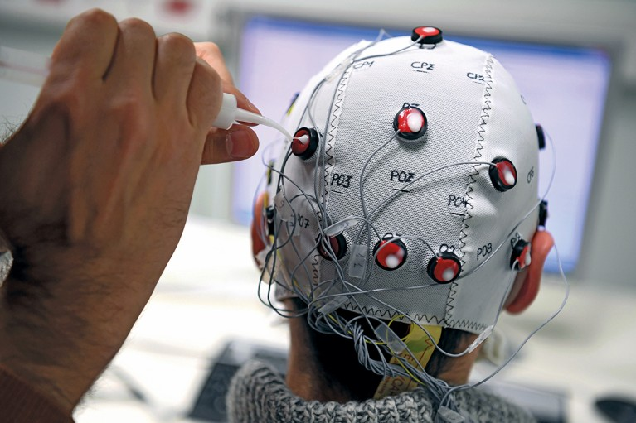
Supervised Learning Model for Motor Movement Prediction using Brain-Computer Interfaces
Presented by
Angel Barrera
Master’s Student in Applied Data Science
East Tennessee State University

Slide 2
Agenda
Introduction
Project Objectives
Dataset Overview
Preprocessing & Data Cleaning
Feature Engineering
Balancing & Splitting the Data

Slide 3
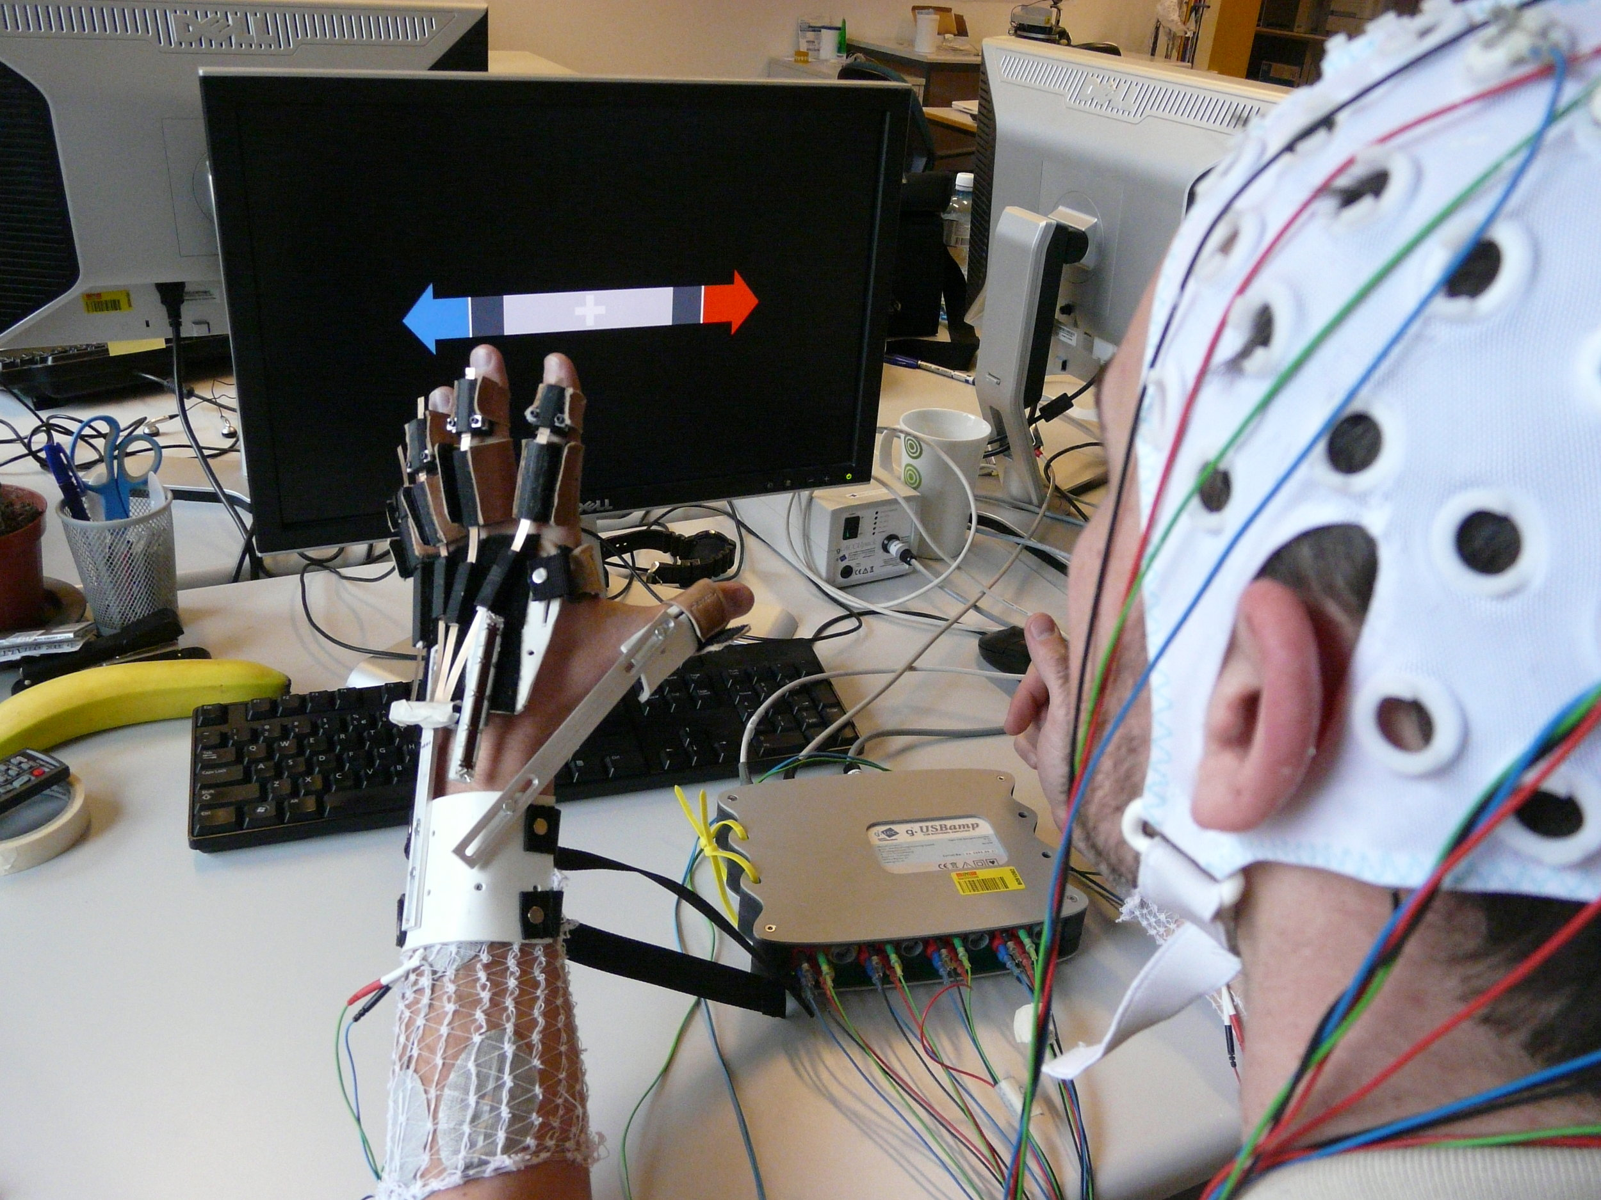
Introduction
Background & Motivation
Brain-Computer Interfaces (BCI) enable direct communication between the brain and external devices.
EEG (Electroencephalography) signals are widely used for motor imagery-based BCI applications.
The goal is to classify motor movements (left fist, right fist, both feet) based on EEG recordings.
Inspired by the field of neuroscience and its potential to help people recover movement and overcome neurological challenges.
My long-term goal is to contribute to the development of BCI systems that restore mobility for individuals with paralysis or motor impairments.
This project serves as a steppingstone toward understanding how EEG-based movement classification can be applied to assistive technologies and neurorehabilitation.

Slide 4
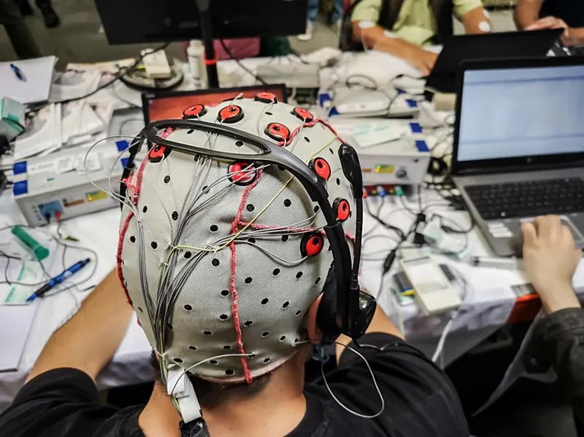

Project Objectives
Unlock patterns in EEG signals: Identify meaningful brain activity associated with motor movements.
Classify movement intentions: Use machine learning to distinguish between rest, left fist, right fist, and both feet movements.
Ensure model accuracy & reliability: Implement a robust feature engineering and balancing techniques for optimal classification.
Bridge neuroscience & technology: Lay the groundwork for EEG-based brain-computer interfaces (BCIs) that can assist individuals with movement impairments.
Scalability for real-world applications: Create a classification framework that can be extended to real-time BCI systems, simulations, and neurorehabilitation tools.
BCI
Supervised Learning Model for Motor Movement Prediction using Brain-Computer Interfaces

Slide 5
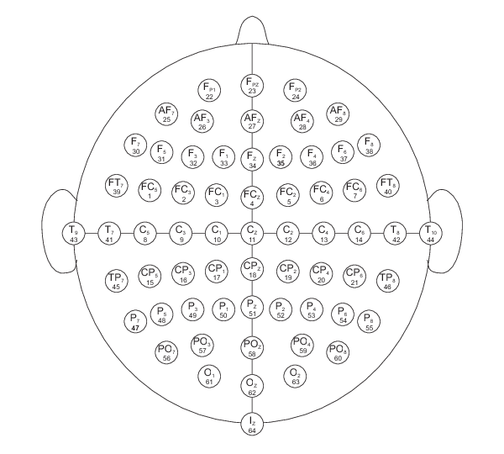
Dataset Overview
EEG Motor Movement/Imagery Dataset
Provided by PhysioNet and recorded using the BCI2000 system.
109 subjects performed 14 experimental runs, including real and imagined motor movements.
Each subject completed:
Resting-state EEG (eyes open/closed)
Motor movement tasks (left/right fist, both fists/feet)
Motor imagery tasks (imagined movements)
64-channel (electrodes) EEG data, recorded at 160 Hz.
Annotations:
T0: Rest
T1: Left fist / Both fists (based on session)
T2: Right fist / Both feet (based on session)

Slide 6
Understanding EEG Frequency Bands
EEG signals are composed of different frequency bands, each associated with various brain functions. When analyzing motor movements using EEG, the Mu, Beta, and Gamma bands are particularly relevant.
Mu Band (8–12 Hz)
Function: The Mu rhythm is closely associated with motor control and sensorimotor processing.
Associated with: Motor planning, execution, and imagery, particularly observed over the sensorimotor cortex, when a person performs a movement or observes another person moving.
Location: Most prominent in the sensorimotor cortex (around the central electrodes like C3, Cz, C4).
Motor-Related Activity:
At rest: Strong Mu activity is observed when no movement is occurring.
During movement or motor imagery: Mu activity suppresses (Mu desynchronization), meaning it decreases when the brain prepares for or executes movement.
Importance in BCI:
Mu suppression is a key feature for detecting real and imagined movements in Brain-Computer Interfaces.
Beta Band (13–30 Hz)
Function: Associated with motor planning, execution, and post-movement feedback.
Associated with: Active thinking, focused attention, alertness, and motor execution
Location: Found in motor cortex regions, often overlapping with Mu activity.
Motor-Related Activity:
Beta desynchronization (decrease in power) occurs before and during movement.
Beta rebound (increase in power) happens after movement ends, likely related to motor inhibition.
Importance in BCI:
Beta band activity is useful for distinguishing different motor states (movement vs. rest).
Beta rhythms can provide real-time feedback in movement-based BCIs.
Gamma Band (30 Hz - Above)
Function: Linked to motor learning, sensory processing, and cognitive functions.
Associated with: High-level cognitive functions like complex information processing, memory retrieval, and conscious perception
Location: Distributed across the sensorimotor cortex but more pronounced in higher-order cortical areas.
Motor-Related Activity:
Increases in gamma activity have been observed during movement initiation and execution.
Plays a role in coordinating movement commands across different brain regions.
Importance in BCI:
Gamma band features are useful in distinguishing complex movements and mental states.
Some studies suggest that gamma synchronization is involved in high-level motor control.

Slide 7
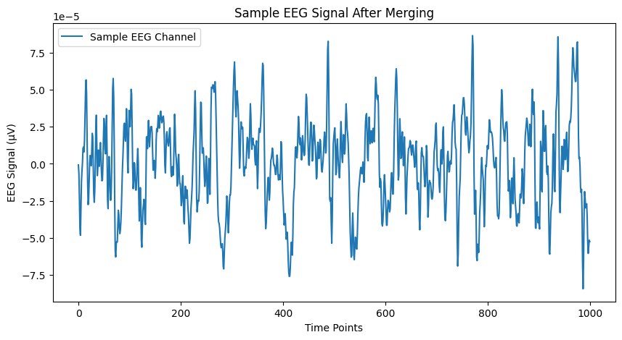
Preprocessing & Data Cleaning
EDF File Handling: Extracted EEG signals from European Data Format (EDF) files, which store multi-channel physiological signals.
Merging Multiple Sessions: Since each session captures only specific movement types, I merged data from multiple runs to create a dataset that includes all movement classes.
Filtering: Since the dataset records EEG signals at 160 Hz, it captures 160 data points per second for each of the 64 electrodes. While this provides a detailed view of brain activity, not all of them are relevant for motor movement classification. In addition, it also introduces unwanted noise. EEG signals contain noise from muscle activity, electrical interference, and low-frequency drift. Therefore, applying a bandpass filter (1-40 Hz) to remove unwanted frequencies was a crucial step.
Low frequencies (<1 Hz): Remove baseline drift (slow fluctuations). Slow fluctuations in EEG are caused by electrode movement, skin potentials, and environmental interference.
High frequencies (>40 Hz): Reduce muscle artifacts (EMG signals from facial/muscle movement) and electrical noise (power line interference typically 50/60 Hz from electrical devices).
Why 1-40 Hz? Motor-related EEG activity mainly occurs in the Mu (8-12 Hz) and Beta (13-30 Hz) frequency bands. Keeping up to 40 Hz guarantees we retain Gamma-band activity (above 30 Hz), which may also play a role in motor control. The bandpass filter removes artifacts without distorting relevant EEG patterns, leading to a cleaner signal for feature extraction.
Scaling the data: we applied Standard Scaling (Z-score normalization) given than
some features have very small values. If we dind’t do this, the model
might give too much to CSP features (since they have larges values).
Missing Value Handling: Identified and handled missing values in extracted features.

Slide 8
Transformation from 64-Channel EEG Signals to 12 Final Features
1) Raw EEG Data (64 Channels)
Initially, we have 64 channels (electrodes) recording EEG signals at 160 Hz.
The raw data looks like this:
This high-dimensional raw data is too complex to directly use in a machine-learning model. We need to extract meaningful information while reducing redundancy.
2) Preprocessing
EEG signals contain noise (muscle artifacts, baseline drift, electrical interference).
Thefore, we use the bandpass filter (1-40 Hz) to remove irrelevant frequencies.
After filtering, the signal remains cleaned but still in 64-channel format.
3) Feature Extraction
We extract three types of features to summarize the important characteristics of EEG signals.
Time (s) | Channel 1 (FC5) | Channel 2 (FC3) | Channel 3 (FC1) | ... | Channel 64 (Iz)
0 | 3.2 µV | -2.1 µV | 1.5 µV | ... | -0.8 µV
0.006 | 3.3 µV | -2.0 µV | 1.4 µV | ... | -0.9 µV
0.012 | 3.1 µV | -2.3 µV | 1.6 µV | ... | -0.7 µV
... | ... | ... | ... | ... | ...

Slide 9
Transformation from 64-Channel EEG Signals to 12 Final Features
3) Feature Extraction
Time-Domain Features (Statistical Analysis).
We calculate statistical values from each EEG channel:
Mean (average signal amplitude)
Variance (signal fluctuation)
Root Mean Square (RMS - overall power)
Hjorth Parameters (Activity, Mobility, Complexity - signal dynamics)
After this step, we now have 6 new features per channel, making a 64 × 6 matrix.
Frequency-Domain Features (Fourier Transform & Power Spectral Density)
We analyze how power is distributed across different EEG frequencies:
Power Spectral Density (PSD)
FFT Mean (Fourier Transform)
After this step, we get 2 new features per channel, leading to a 64 × 2 matrix.
Spatial Features (Common Spatial Patterns - CSP)
CSP It’s widely used in BCI systems because it amplifies relevant neural activity while reducing background noise Instead of treating channels independently. CSP finds spatial filters that emphasize key movement-related activity by:
Computing covariance matrices for EEG trials.
Solving a generalized eigenvalue problem to get projection filters.
Transforming the EEG signals into a low-dimensional representation.
This gives us 4 CSP features, reducing the dimensionality significantly.
Now, instead of 64 raw EEG channels, we have a compact and meaningful representation of 12 features:
Mean | Variance | RMS | Hjorth Activity | Hjorth Mobility | Hjorth Complexity | FFT Mean | PSD Mean | CSP 1 | CSP 2 | CSP 3 | CSP 4 | Movement Label
1.50E-09 | 1.40E-09 | 0.000038 | 1.40E-09 | 0.38 | 0.92 | 0.0042 | 1.70E-11 | -0.25 | 0.49 | 0.68 | -2.49 | 1
6.00E-11 | 1.50E-09 | 0.000039 | 1.50E-09 | 0.37 | 0.88 | 0.0043 | 1.90E-11 | 1.31 | -1.03 | -0.78 | -1.38 | 1
-1.70E-09 | 1.60E-09 | 0.00004 | 1.60E-09 | 0.36 | 0.87 | 0.0043 | 2.00E-11 | -0.44 | -0.76 | -0.52 | -1.57 | 1
... | ... | ... | ... | ... | ... | ... | ... | ... | ... | ... | ... | ...

Slide 10
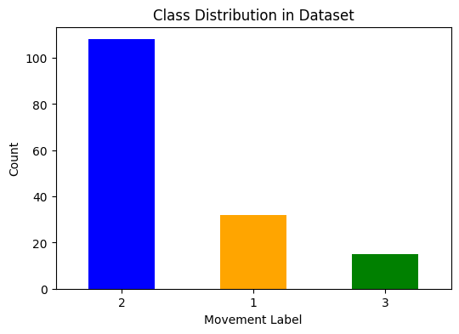
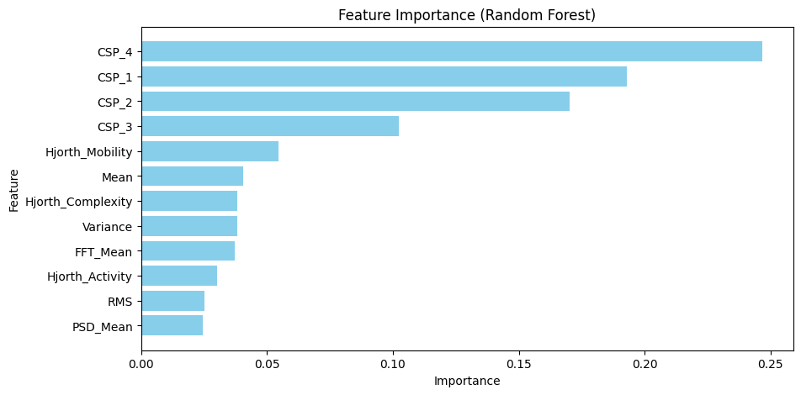
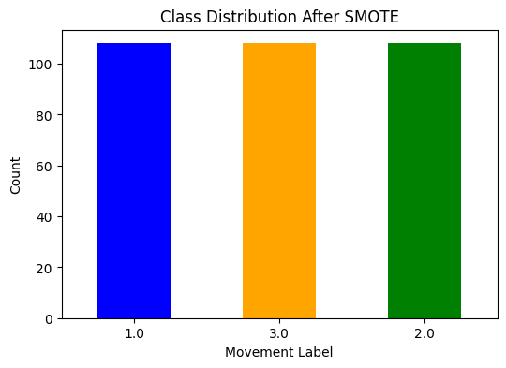
Balancing The Data
Class Imbalance Handling
Initial dataset was highly imbalanced (more instances of one movement type).
Applied SMOTE (Synthetic Minority Oversampling Technique) to create balanced classes.
Feature Importance Analysis
Top contributing features: CSP components & Hjorth Mobility.
Spatial patterns (CSP) played the most significant role in distinguishing movements.

Slide 11
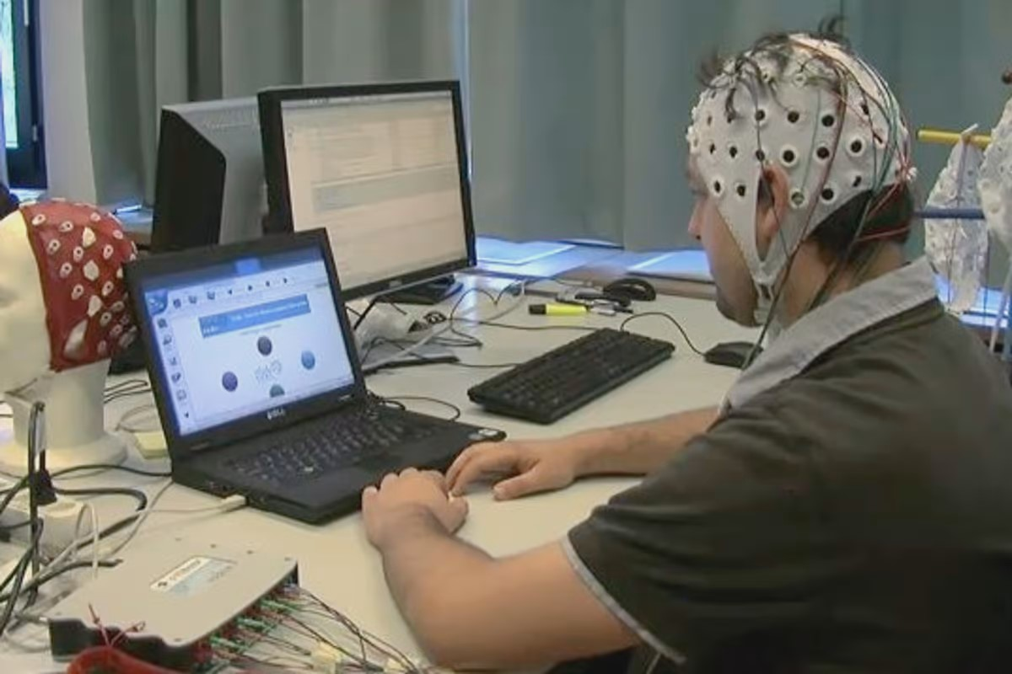
Model Training
Machine Learning Model to Be Used
Random Forest Classifier (interpretable and robust for EEG data)
Evaluated on:
Accuracy.
Precision, Recall, F1-score
Confusion Matrix
What to Expect From the Results
For the model to effectively classify motor intentions using EEG data.
To use CSP Features for classifying left/right fist and feet movements.
To have a high classification accuracy so we can potentially do a real-time application in BCI systems.
Supervised Learning Model for Motor Movement Prediction using Brain-Computer Interfaces

Slide 12
Future Work
Fit the model and analyze the results.
Deploy model on real-time BCI simulation, Unreal Engine, or Unity.
Test on additional subjects to ensure robustness.
Optimize feature selection to reduce dimensionality without accuracy loss.
Explore deep learning approaches (CNNs on EEG signal matrices).

Slide 13
Thank You
Angel Barrera
Master’s Student in Applied Data Science
East Tennessee State University

